Slide 1


Project PI FullstackJS
Option : TWIN
Virtual Learning Assistant
Flash-Learning

Slide 2




Team : The Outsiders
2
Missaooui Khalil
Rabhi Salmene
Rhaiem Chedy
Saghir Saghir

Slide 3
The purpose of the
presentation
3
How are we going to advertize it ?
What is the problem in the existent market ?
01
06
How does it work ?
Why our chatbot and not the competitors?
05
Virtual Learning
Assistant
Flash-Learning
02
Introducing the market and problem Statement
list of competitors and their shortcomings
Our Chatbot innovative aspects and promises
What does it do ?
What is it ?
Our Chatbot features and benefits
Our Chatbot functioning process
04
03
Our Chatbot advertising strategy

Slide 4
PLAN
05
Conclusion
04
03
02
Introduction
01
Part3
Advertising Strategy
Advertising material
Part2
Introducing the product
Product Description
Process Description
Part1
Introducing the market
Problem Statement
Competition

Slide 5
Part 1

Slide 6
Part 1
6
01
Introducing the market
03
Competition
02
Problem Statement

Slide 7
Introducing the market
7
Chatbot was spread in 2016, it is used to simplify the use and to make
client experience easy.
They weren’t as successful as they have been expected however we
still use them too often nowadays.
Many websites nowadays use Chatbot like « Facebook », « Amazon »,
« Alibaba express ».
With the arrival of Artificial Intelligence, new generation conversational
agents are more efficient, smarter, and above all more human.

Slide 8
Problem Statement
8
very limited at the moment
No emotion detection
Bad user experience
Lack of Chatbots in
e-learning
frustrating to use and not helpful at all
Notes:
After doing some research we concluded that there is a saturation of Chatbots in various domains ,
over-existing isn't a problem if they offer various services , the problem is : similarity ! they are too typical ,
they don't give you a good using experience , as boring as a reception employee who's been serving people
for several years , he doesn't care about your experience , he doesn't care how you feel , he is only trying to
finish his tasks with the least effort and get out , that's not the way you want to treat a student ! He is already
one step away from giving up , user’s experience and feature richness is vital to attract , encourage and push
students towards the right way .

Slide 9
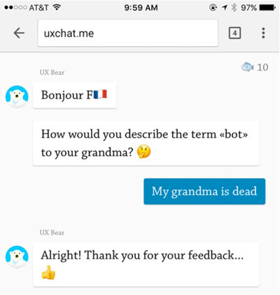
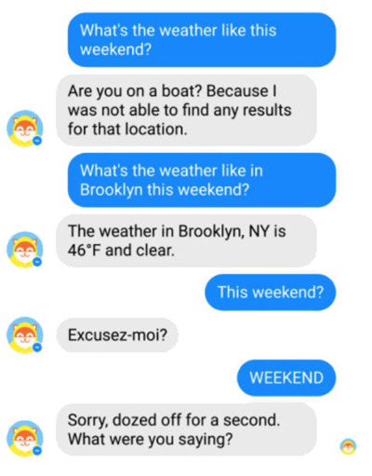
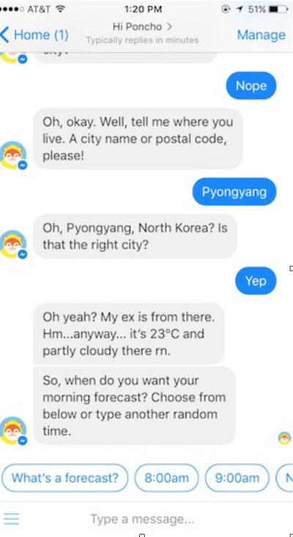

Slide 10
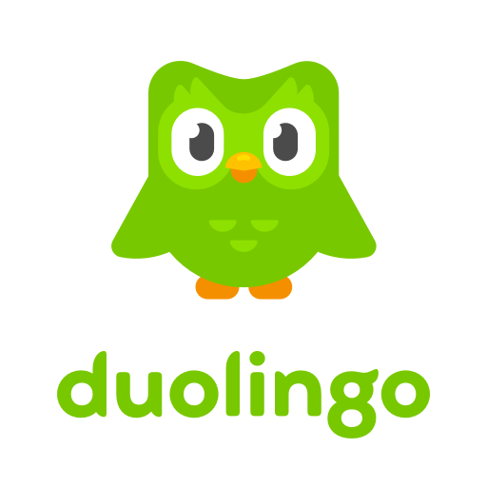
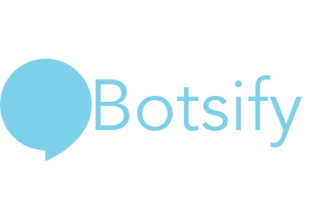

Competition
advantages
disadvantages

Slide 11
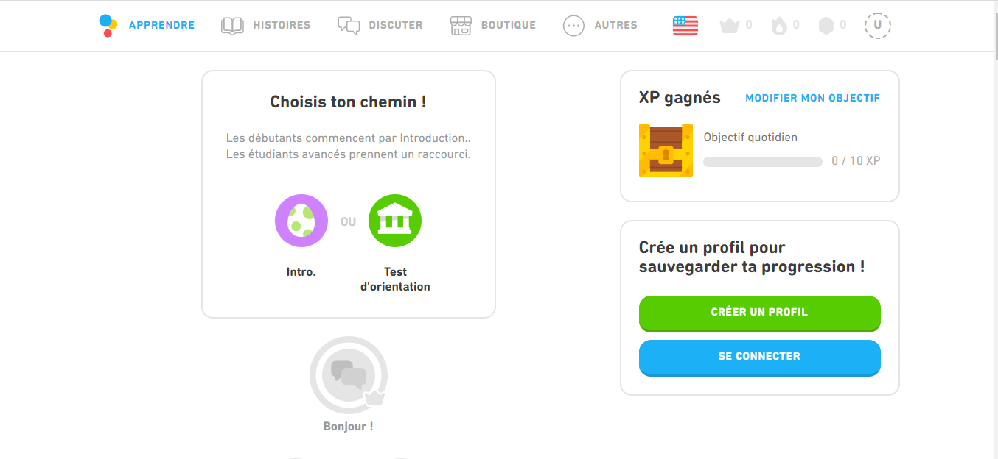
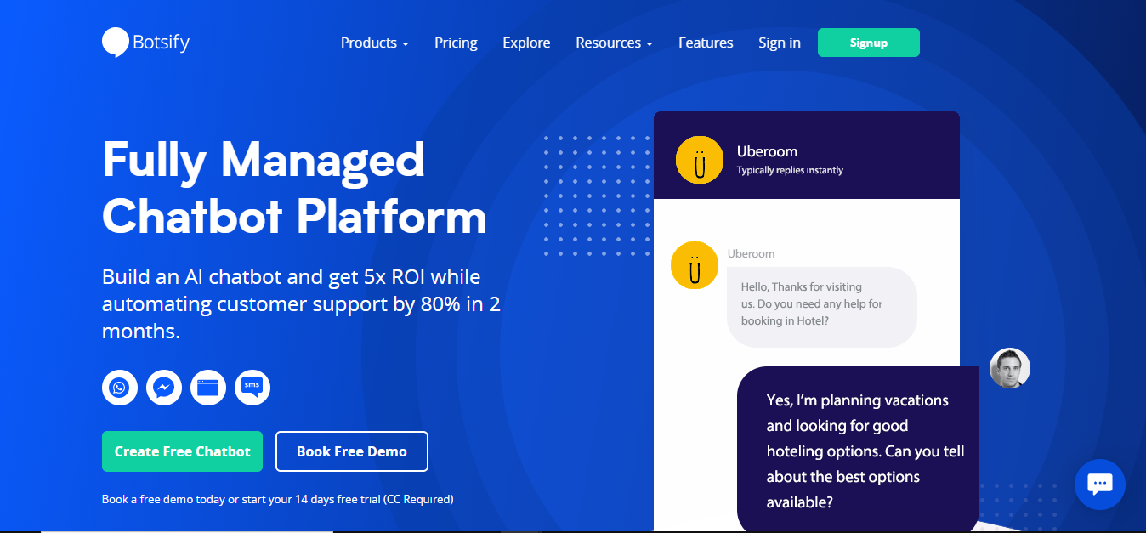
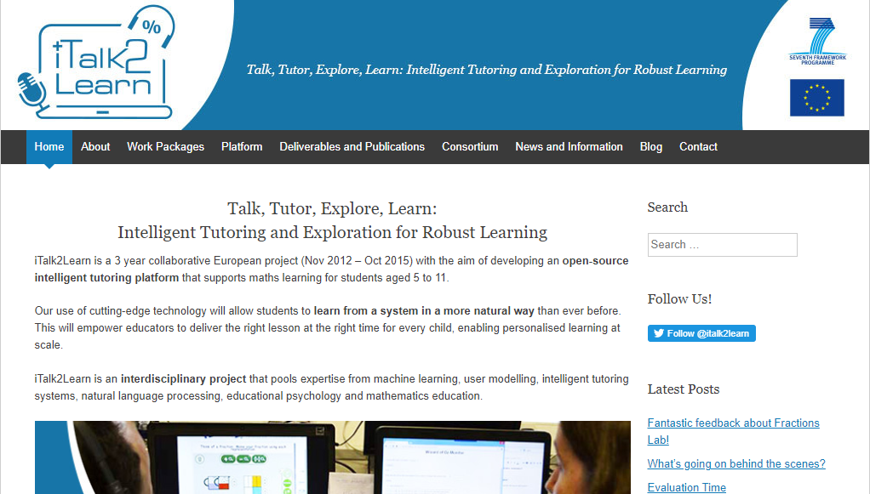
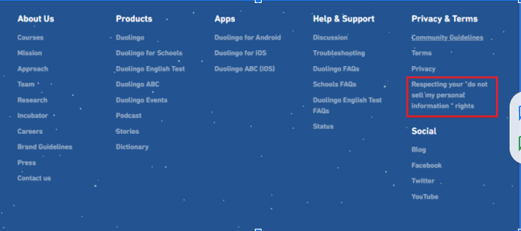
11
Interpretation
Duolingo
Low data collection
No emotional detection
No reources management
Not extensible
No report section
Botsify
bad entity feature
not free (50$ per month)
not possible to do any kind of optimization
iTalk2Learn
no data scraping
Complex usage
Bad design
Low learner classification
No smart interactions

Slide 12
Part 2
Part 1

Slide 13
Part 2
13
01
Introducing the product(innovative aspects and promises)
03
Process Description
02
Product Description

Slide 14
the product(innovative aspects and promises)
01
smart notifications and reminders for better & faster advancement
02
The ability to integrate the Chatbot on multiple platforms
03
Getting insights from incoming leads
Possibility of optimisation due to learners thoughts and opinions.
04
Dynamic, Better designed, structured application ,easy, simple to use
Notes:
Now moving to the product innovative aspects and promises we tried to build an application that its main goals are :
-smart notifications and reminders for better & faster advancement
-our chatbot will have The ability to be integrated on multiple platforms destined for e-learning such as udemy or coursera
-Also our application will get insights from incoming leads and here we are talking about the possibility of optimisation due to learners thoughts and opinions in the section report
And finally our chatbot will be dynamic ,better designed and well structred application,also it will be easy and simple to use

Slide 15
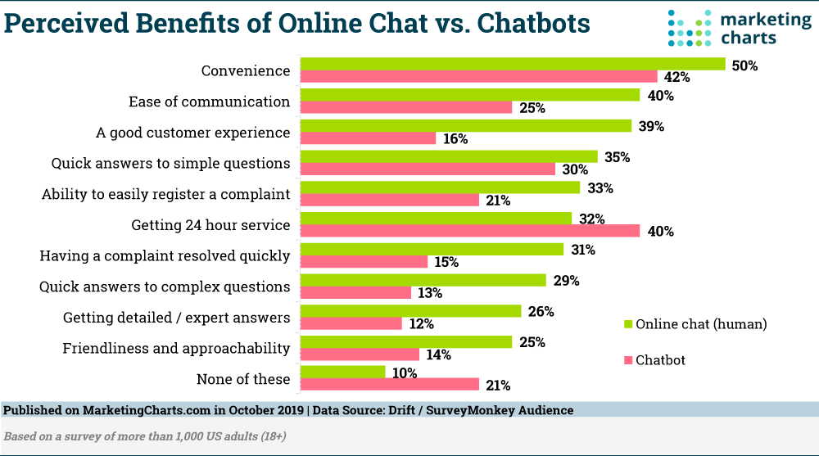
Product-Service Description (Features- Benefits chart)
Notes:
As u can see this chart shows the benefits and the advantages granted by chatbotts versus the online chat:
The survey shows that online chat is more convenient,easier to communicate with ,provides a good customer experience,easier to report a problem and more friendly meanwhile the chatbots’ only advantage that is available 24hours
Reading this chart carefully allowed us to observe that our chatbot must be perfect to avoid these problem and make students think about relying more on flash learning in their studies

Slide 16
Process Description
Blasset el video

Slide 17
Part 3
Part 2
Part 1

Slide 18
Part 3
18
01
Advertising Strategy (Selling messages and advertising media)
02
Advertising material

Slide 19
Advertising Strategy
19
Ads
Adding a call-to-action on our blog or website to get in touch with learners
Social Media
Track the effectiveness
of our bot with
special UTMs and
discount codes
end simple surveys to our contacts
Sponsors

Slide 20
There’s a huge difference between a bot answering “yes” or “no” questions and a bot that provides meaningful experiences.
Are you fed up from your teacher??, it may be time to get a little help from some digital friend.
It is time to master your courses from your couch
No need for paid training to excel in courses!! Our Chatbot will grant it for free

Slide 21
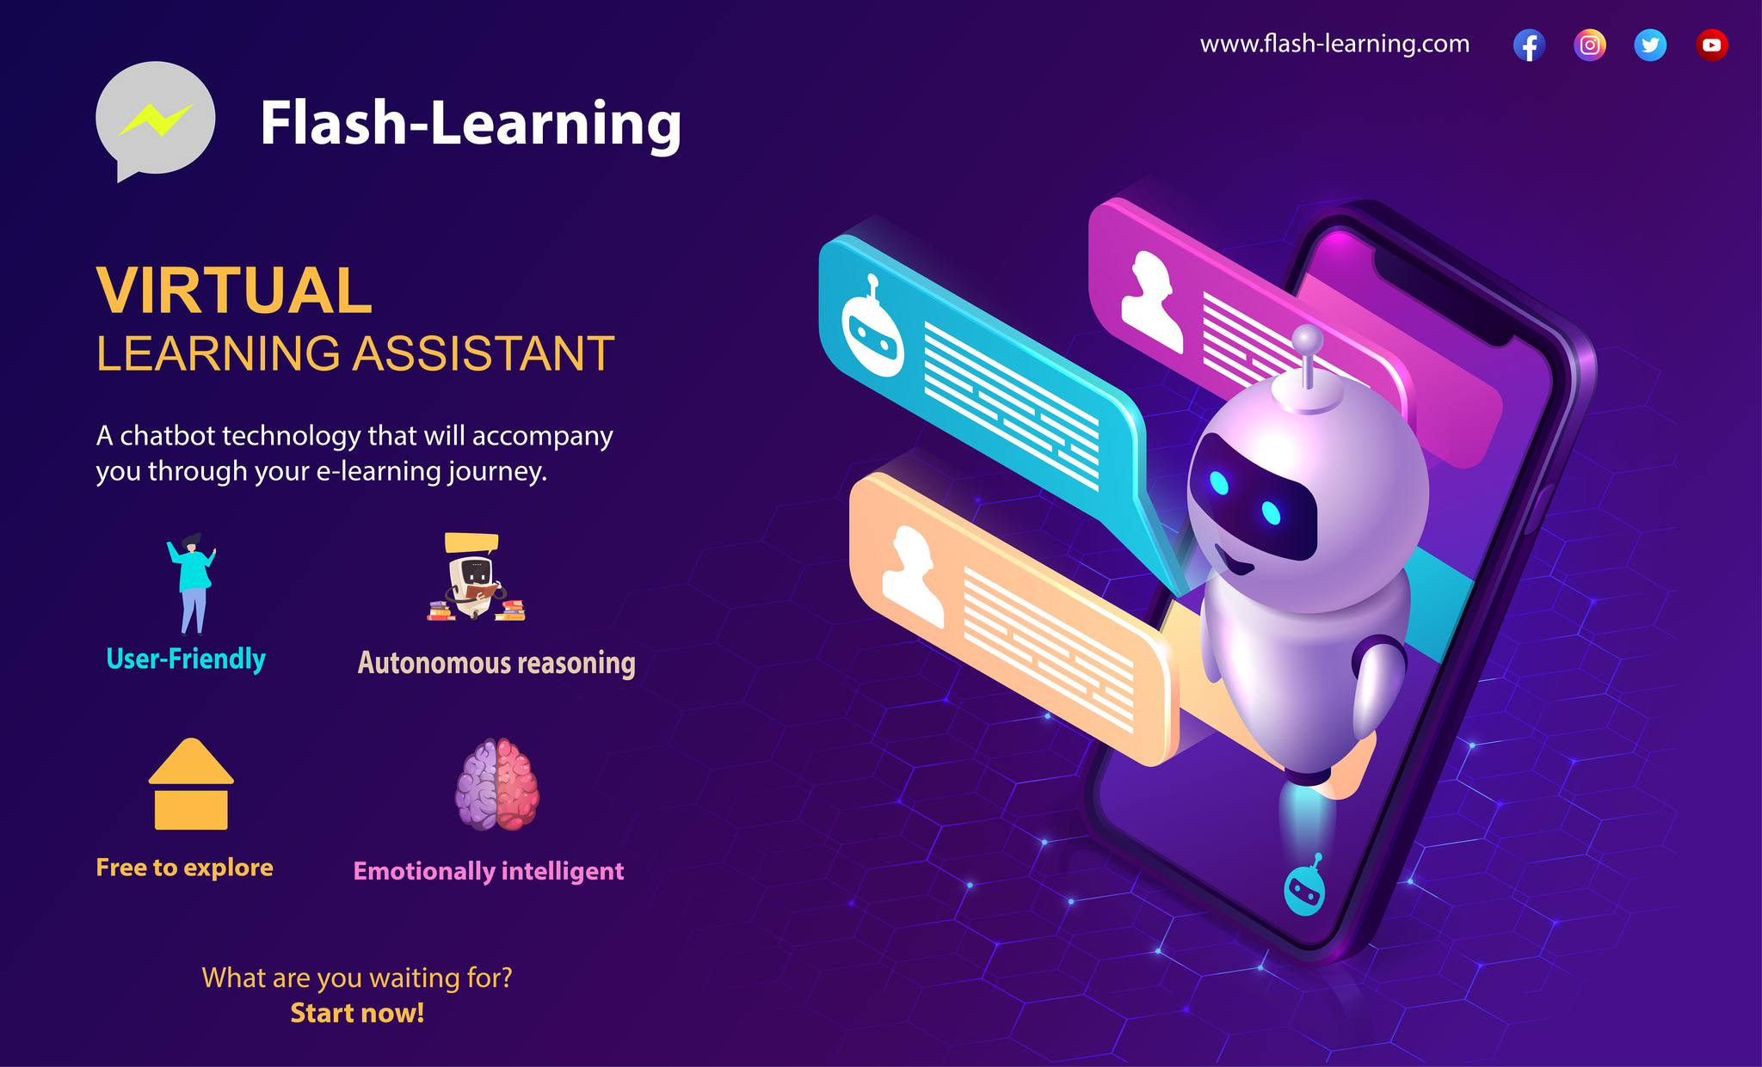
Advertising material

Slide 22
Conclusion
BILL GATES once said:
“We always overestimate the change that will occur in the next two years and underestimate the change that will occur in the next ten. Don't let yourself be lulled into inaction.”
So what prevents us from creating the most interactive e-learning Chatbot and prevents you from using it and enjoying your learning experience!!

Slide 23
23
Thank you for your attention

